Slide 1
Oct 25 Tagup

Slide 2
Analysis of the Oct. 26 Event
Environmental Context
Spacecraft Location
Observed Magnetic field
Magnetic field line and footprints
Pitch Angle Distributions
Error Sources and Gyrotropy

Slide 3
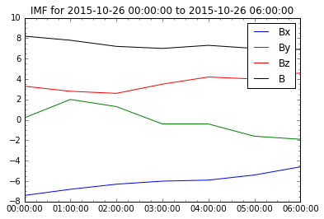
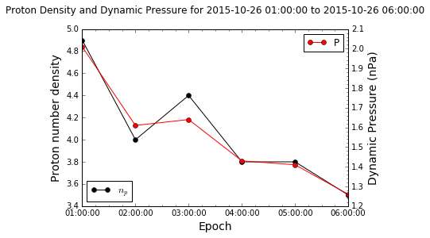
Environmental Context (1/2)
IMF is steady with a weak By, and a steady Bz ~4 nT
The solar wind conditions so a low end pressure with little variation in speed (495-464 km/s)

Slide 4
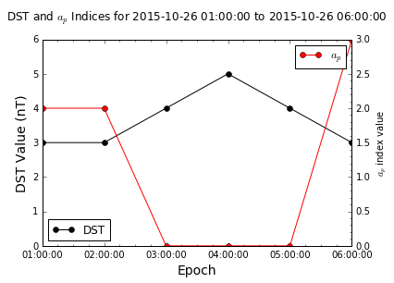
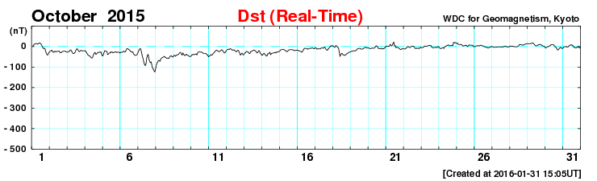
Environmental Context (2/2)
a_{p} index very low (equivalent K_{p} of 0)
The DST values are also very low (for comparison the month of October is shown as well)

Slide 5
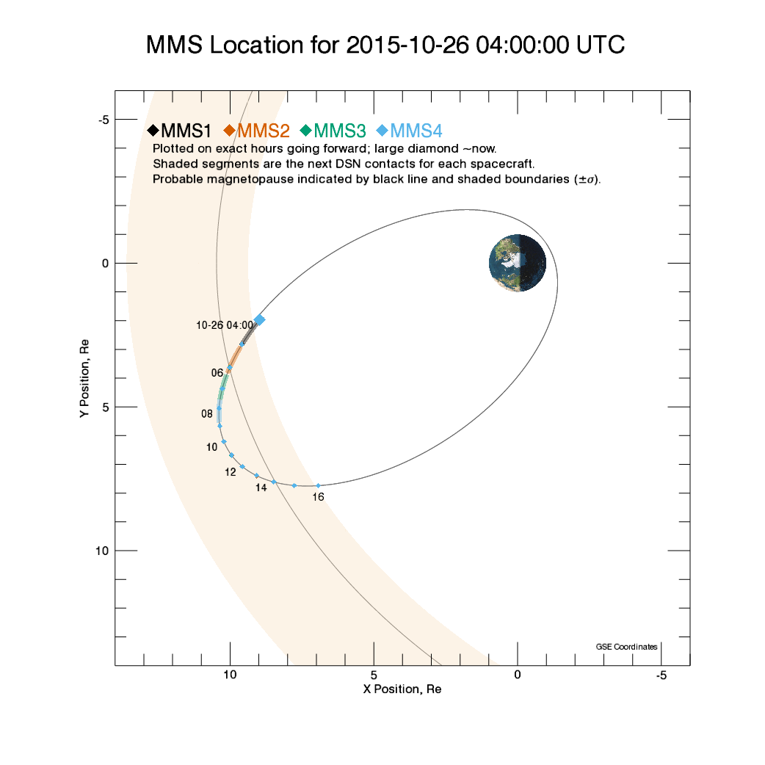
Spacecraft Location

Slide 6
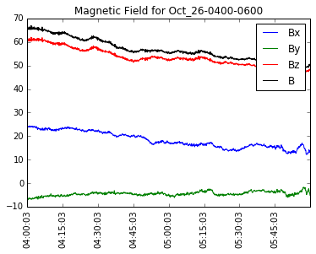
Magnetic Field

Slide 7
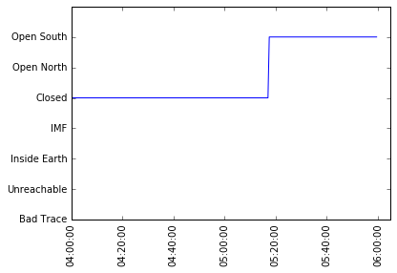
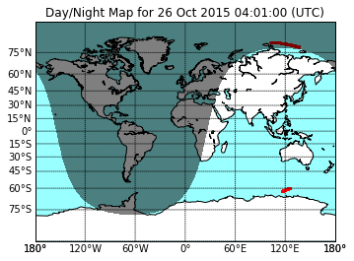
Magnetic Footprints
The field line lines seen by the spacecraft are closed
Footprints, adjusting for the height of the ionosphere, are in sunlight
Magnetic local times are:
7.8-9.4 North
0.5-0.8 South
Magnetic latitude are:
85-87.5 degrees North
-47 to -51 degrees South
Valid Range

Slide 8
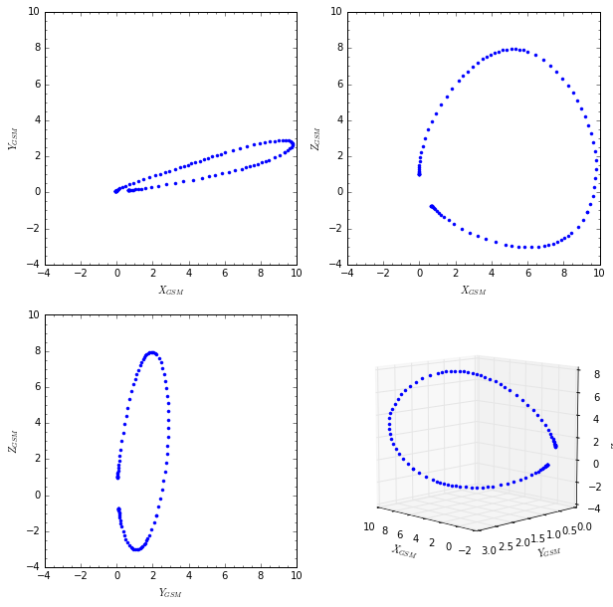
Field Line Trace

Slide 9
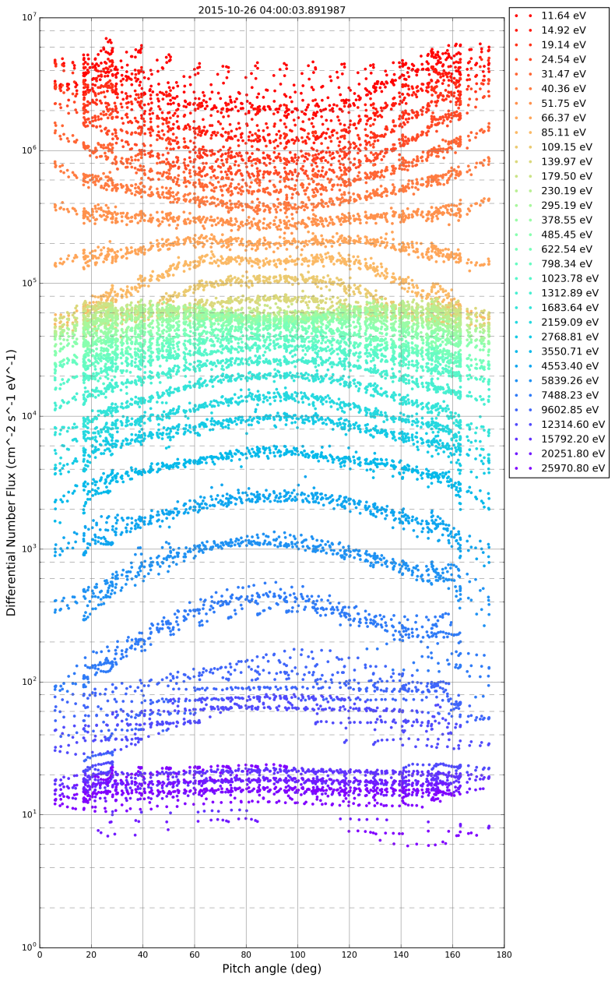
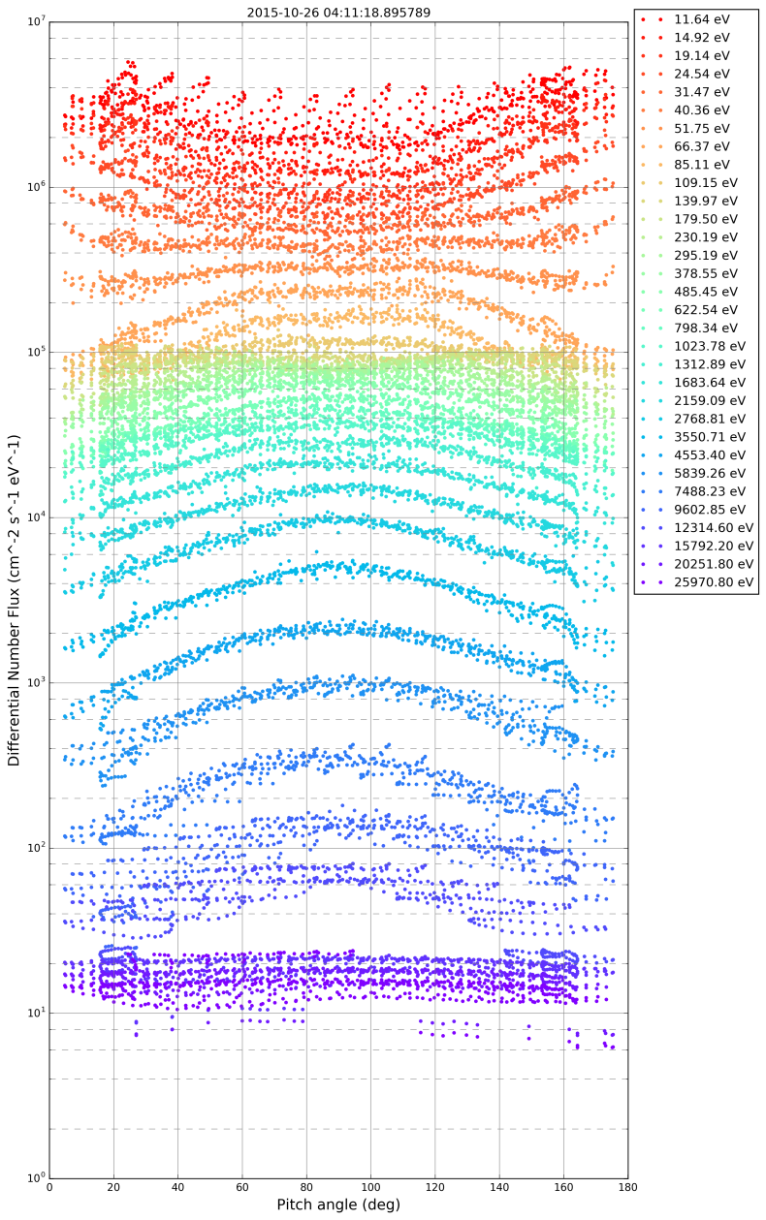
Raw PADs for Selected Times

Slide 10
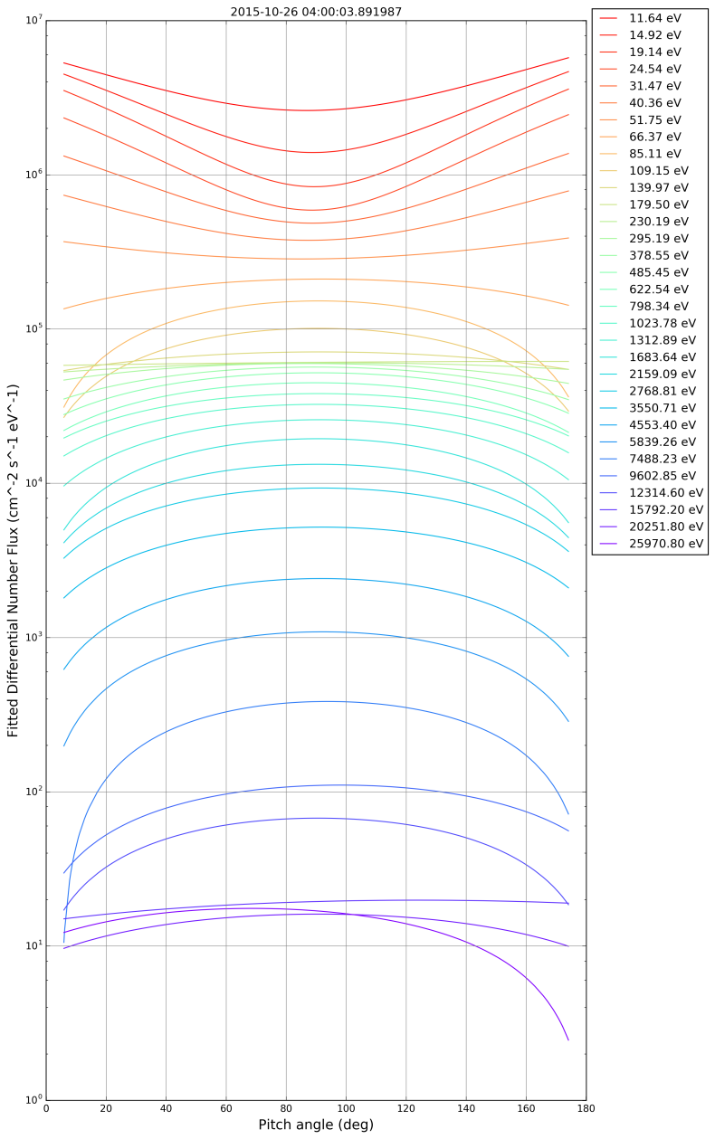
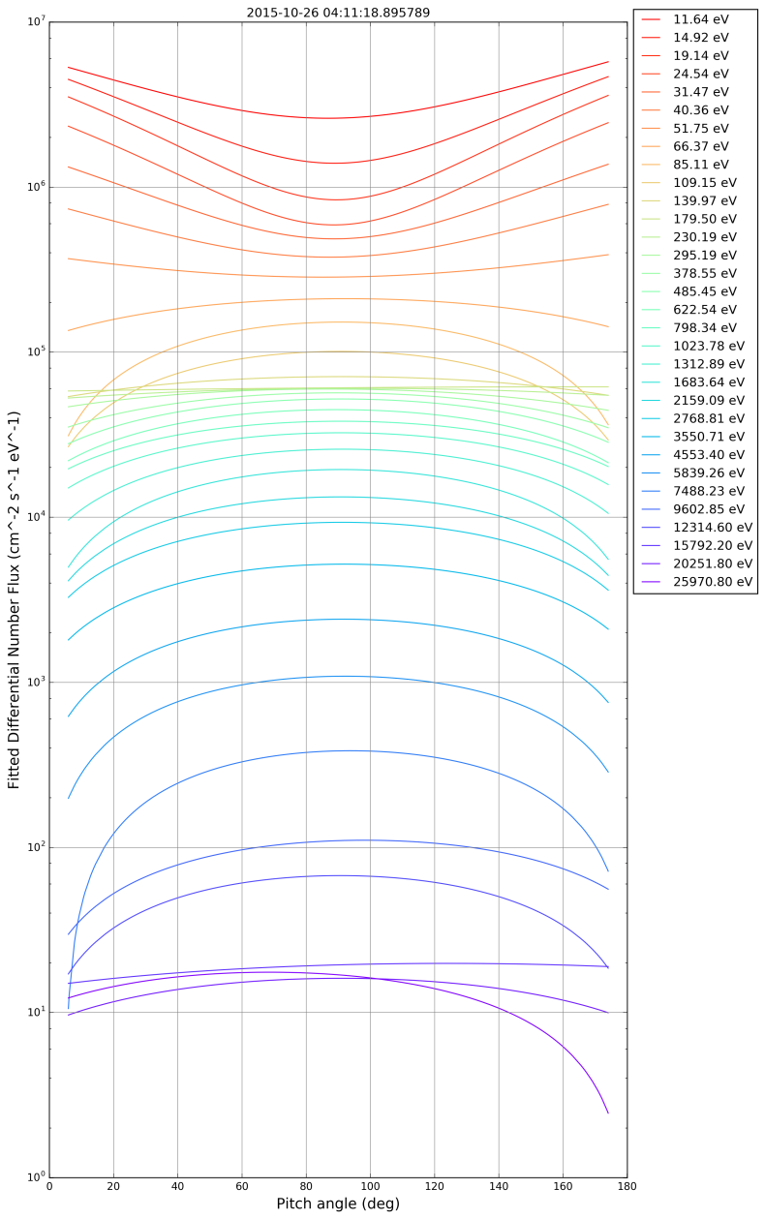
Smooth PADs for Selected Times

Slide 11
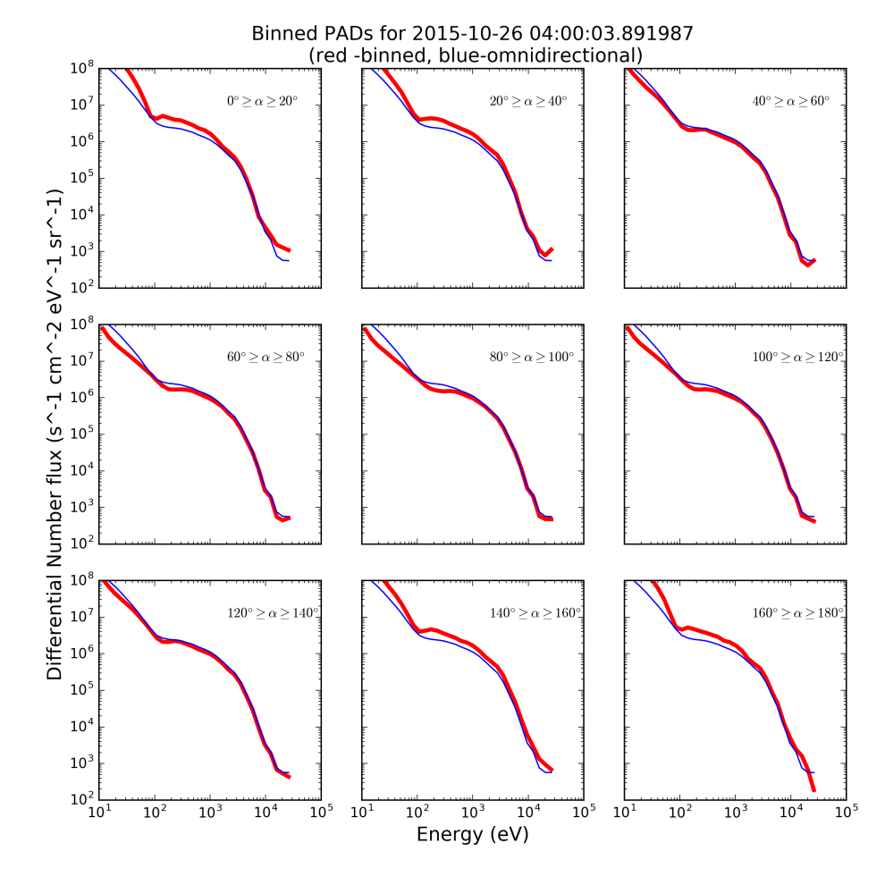
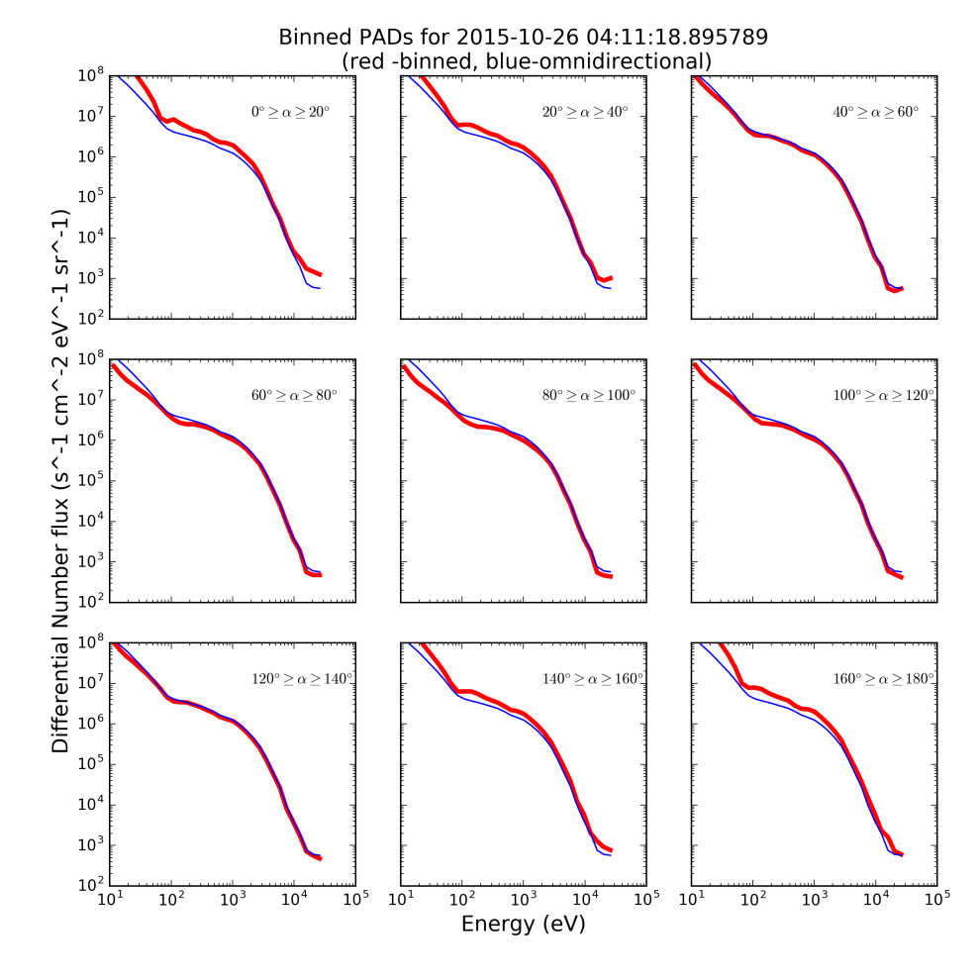
PA-limited spectra for Selected Times

Slide 12
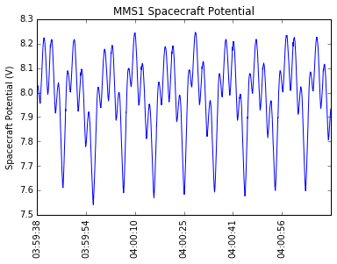
Spacecraft Potential
ASPOC control of spacecraft potential keeps it below the lowest FPI bin
Spacecraft generated photoelectrons can be ignored

Slide 13
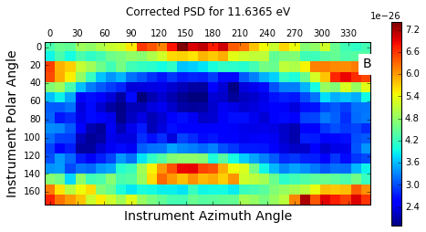
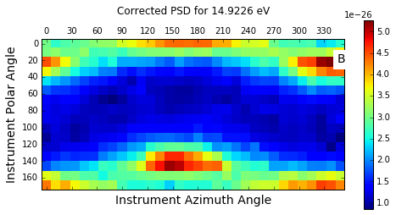
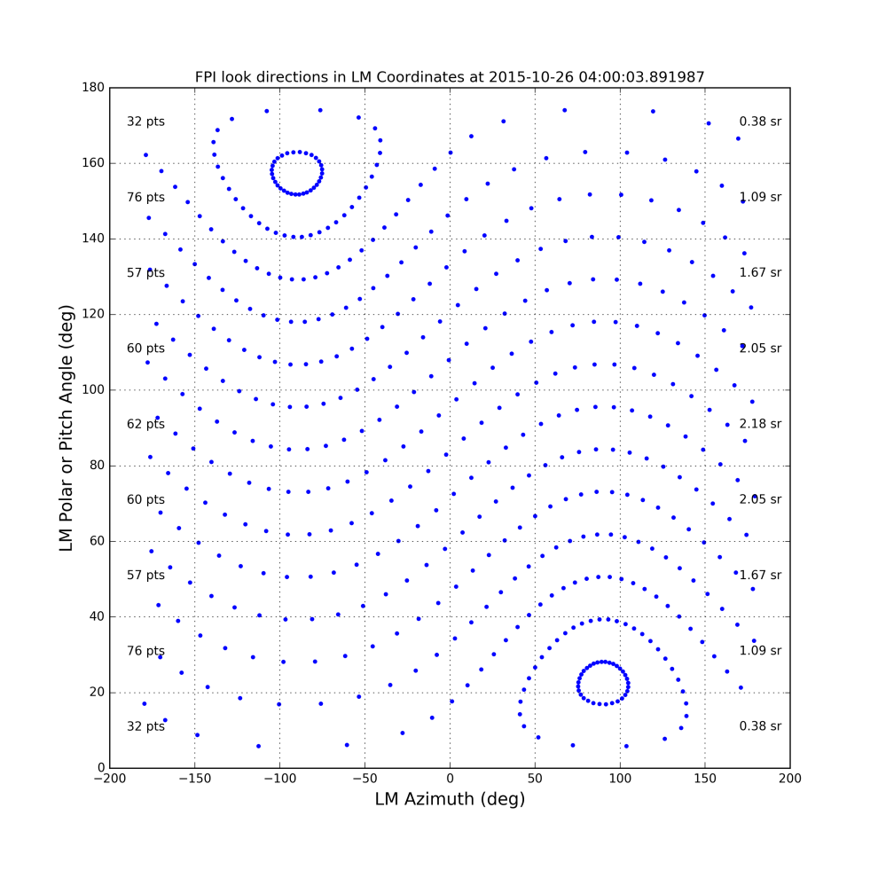
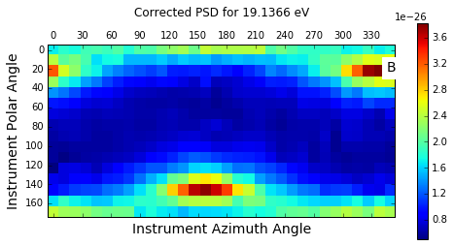
Gyrotropy
Pressure tensor in DBCS
Eigenvalues indicate gyrotropy
λ_{i} = (0.056, 0.069, 0.070) (1st value parallel pressure, the other two are perpendicular)
Low energy counts, when corrected for internally-generated photoelectrons, also show gyrotropy
Lines of constant ‘LM’ azimuth are curved in the s/c body frame like lines of constant instrument azimuth are curved in the LM frame

